Slide 1
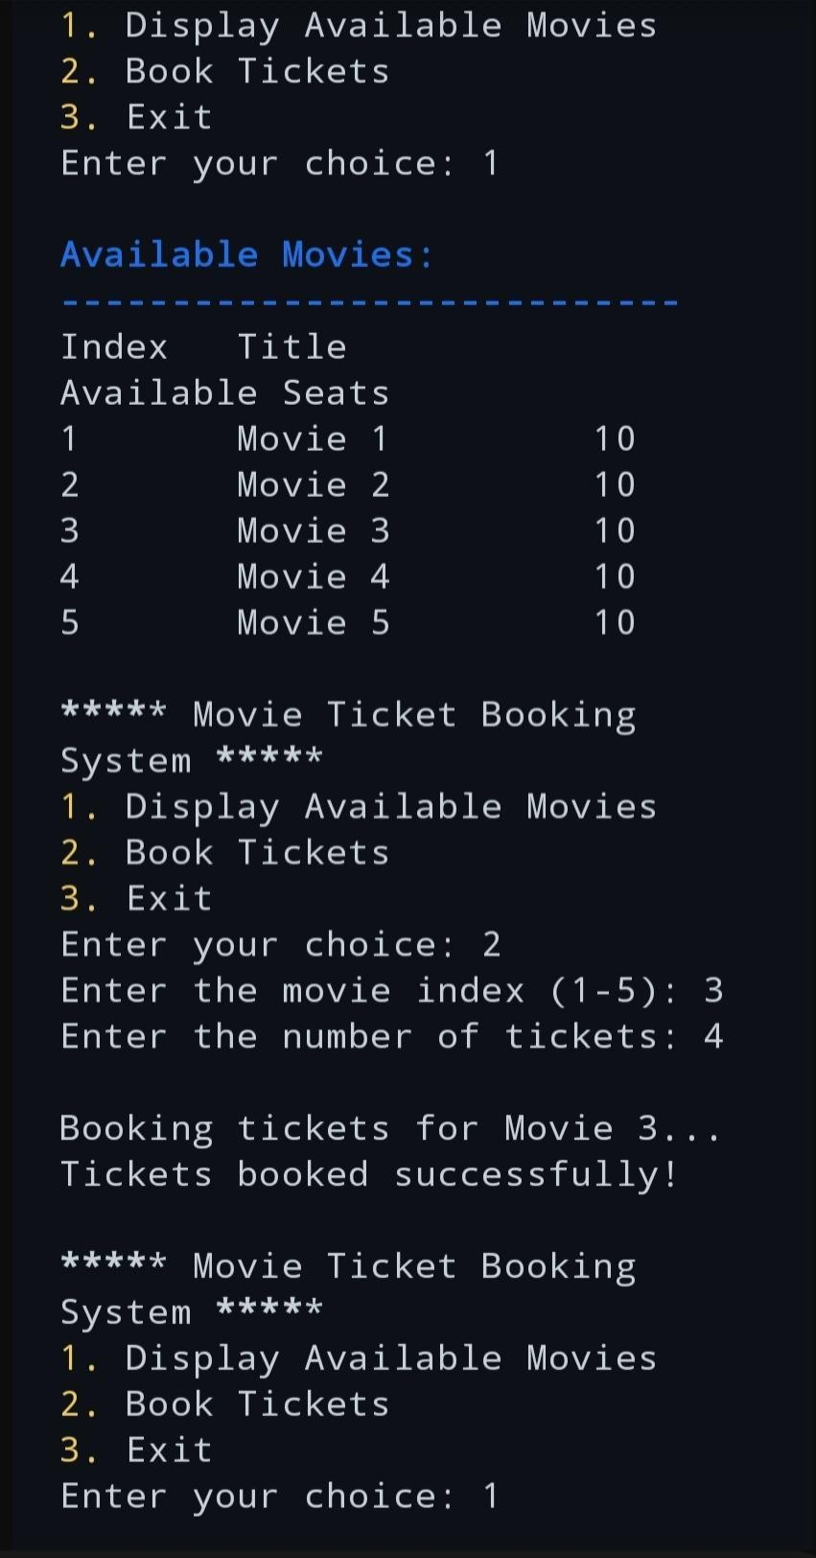
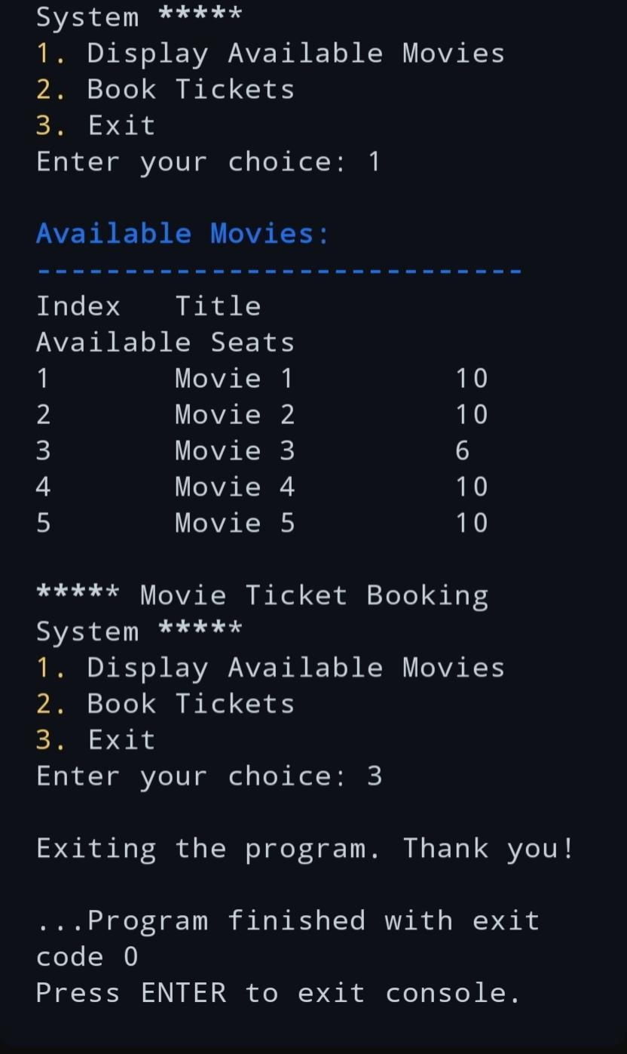
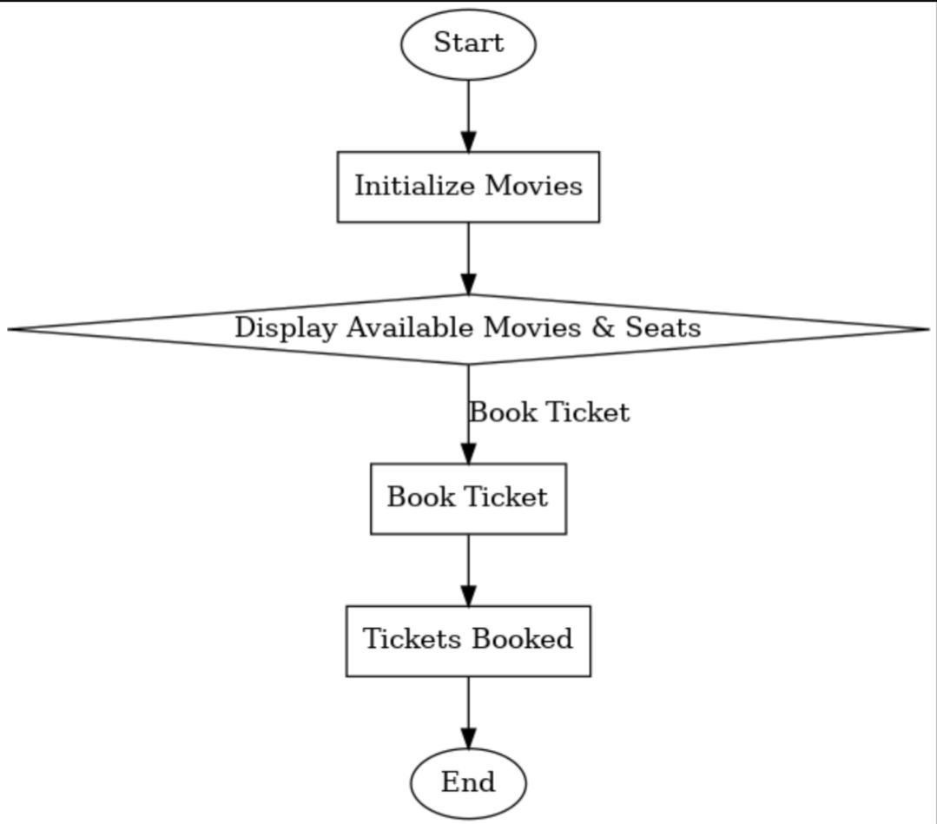



Information Technology A. Y. 2024-25, TERM- ODD
Computer Programming With C (202000110)
PREPARED BY :-
Hiten Malviya(12402130501072)
The movie ticket booking system is a program designed to simplify the management of movie reservations. It allows users to view available movies along with the number of seats remaining and to book tickets efficiently. The system maintains a list of movies with predefined seating capacities and updates seat availability dynamically based on user bookings. By automating the ticket reservation process, this program reduces errors, speeds up transactions, and enhances the overall customer experience. With features such as displaying available movies, checking seat availability, and ticket booking, the system ensures a smooth and organized workflow for managing movie reservations.
The movie ticket booking system streamlines ticket reservations by allowing users to check seat availability and book instantly. It eliminates queues, saves time, and ensures accurate seat management.
The system reduces errors and administrative work,
improving efficiency for cinema operators and providing a seamless booking experience that boosts customer satisfaction and ticket sales.
The movie ticket booking system is an efficient online platform that allows users to check seat availability, book tickets, and confirm their reservations seamlessly. It simplifies the process of purchasing movie tickets, eliminating the need for customers to wait in long queues. This system is highly adaptable and can inspire similar systems to be implemented in other sectors, enhancing customer convenience. With the increasing digitalization worldwide, such electronic ticketing systems represent a significant step forward in making services more accessible and efficient.

